Slide 1


Case Study Template
1

Slide 2

Mini-Project 1 Python
Desir Chasnick
Date: June 25, 2021

Slide 3
Agenda
Introduction - Team, Client, Problem
Systems Analysis of Problem - Review stakeholders, deﬁne measurements of performance
Relevant Analytics - Data sources, Analysis
Alternative Solutions - Explanation of solutions, comparison of outcomes
Results.
Recommendations - What should the client do next? What is the recommended next step?
Appendix - Additional Resources

Slide 4
Introduction
Who i am?
I am Desir Chasnick , a data analyst who actually work for Ayiti Analytics.
What is the problem?
Ayiti Analytics don’t know where he must expand her three future trainings center.
They want to know what three commune in Haiti are most likely to receive these training centers.

Slide 5
Systems Analysis
Who is the client?
The client is AyitiAnalytics.
AyitiAnalytics is the first company who do business consultation and since two years do a bootcamp in Data Science.
They want to improve life quality in Haiti , find solution to national problem with data.
Built the next generation of Data Scientist in Haiti.

Slide 6
Systems Analysis
What is the problem?
Ayiti Analytics plan and organize every year a bootcamp and he want he want to know which three communes in Haiti is most susceptible to receive its training center.
Ayiti Analytics ask too some specific questions related to her major problem like :
-How many week the period application must be extend if we want 60 selected applicants by commune.

Slide 7
Systems Analysis
What is the environnement you are working in?
Haiti is a special country, with an unstable policy where a majority of people do not have reliable access to electricity or the internet.
investments are scarce, the majority of the population is young.
Regularly we have kidnapping gap.

Slide 8
Systems Analysis
Who are the relevant stakeholders?
AyitiAnalytics:
Ayiti Analytics is the first stakeholder because its him who want organize yearly a bootcamp.
Participants:
The applicants are also concerned by this project because they will take 4 months to learn new technichs and skills.And depend of the geographic position of the labs training , it’s can be accessible or not for them.
Sponsors:
AyitiAnalytics can’t do alone this project and for that it want support . The sponsor will be interested to know where the training center will be implant because some commune are not safe and have not the relevant infrastructure.

Slide 9
Systems Analysis
What is a way we can measure success or performance in this environment?
In Haiti and for this special project , AyitiAnalytics can measure success by the ratio of applicants who are successfully completed the bootcamp program.
To be successfully completed this bootcamp you must have 80/100 after your Capstone Project and received a good evaluation for your internship.

Slide 10
Methodology
For this work, I had to in the order of execution:
1-Form a complete database with the data that was provided to me. These data were scattered and fractionated.
2-With the complete dataset, I had to clean it up to remove unnecessary information (non-necessary and repetitive columns) and make it clean for analysis.

Slide 11
Methodology
3-After cleaning the data that I could start to test and do a general univariate analysis of the dataset in order to have an idea on the distribution of the different variables of the data set.
4-The last step was to try to answer each of the questions posed by AyitiAnalytics by processing the data from now on to be ordered.
5-I do my conclusion and recommandation.

Slide 12
Relevant Analytics
What data is important to understanding the situation?
The data necessary for the realization of this project were the data relating to the access to the Internet and to a computer per municipality.
The number of appliers, the duration of the application session.

Slide 13
Relevant Analytics
What are the general insights or takeaways?
The general insight is AyitiAnalytics must chooses thoses communes: “ Delmas, Port-au-Prince, Petion-Ville” to start theirs next training Center.
We have a limited percentage of women who have shown interest.

Slide 14
Potential Solutions
What is the current state?
Currently Ayiti Analytics has a single data science training center in Port-au-Prince with a promotion of 20 students including 4 women.

Slide 15
Potential Solutions
What are the options the client can pursue?
Based on the fact that Ayiti Analytics will always be able to find the necessary resources for the realization of these projects, no matter where. (According to the words of one of the executive members of AyitiAnalytics).
AyitiAnalytics could choose:
- to accept more applications in its current data science center.
-to open a center in each of the 3 main cities of Haiti: Cap-Haitien, Gonaives, Cayes.

Slide 16
Results
Knowing that each cohort must have 30 students
-How many applications must be made to select 25% women for each on average?
Based on the assumption that the same proportion of women as today will register tomorrow and that each will have the same chance of being selected. The calculus give the number of applicants for each cohort to have 25% women on average is : 1410

Slide 17
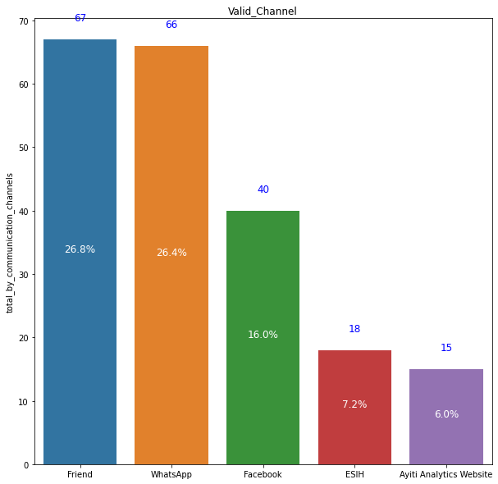
Results
What are the most effective communication channels (alumni , Facebook, WhatsApp,Friend …) that will allow a student to be susceptible to selection?
This table allow us to see the three most effective channel are : Friends , Whatsapp, Facebook.

Slide 18
Results
What is the average number of university students who should participate in this program?
Based on the assumption that the same proportion of students as today will register tomorrow and that each will have the same chance of being selected. The calculus give the number of university students who should participate in this program is : 733

Slide 19
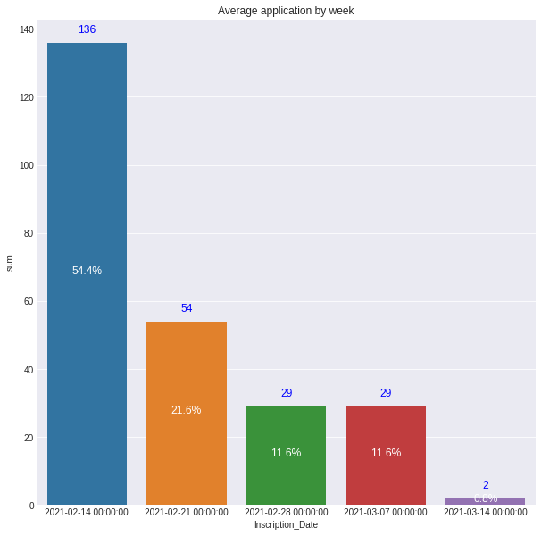
Results
What will be the average number of applications per week that we could have?
Based on our actual data, the average number of applications per week that we could have is : 50.
This graph show us the weekly distribution.

Slide 20
Results
How many weeks should we extend the application process to select 60 students per commune?
Based on the assumption that the same ratio application of students as today will register tomorrow. The number of week we should extend the process to select 60 students by commune who should particpate , our calculus give us :40 weeks.

Slide 21
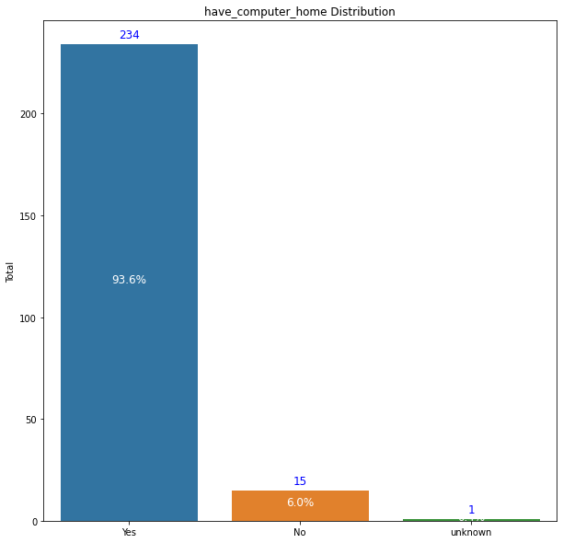
Results
If we were to do all the bootcamp online what percentage of students would have a laptop?
This graph show us 93% of the students would have a laptop.

Slide 22
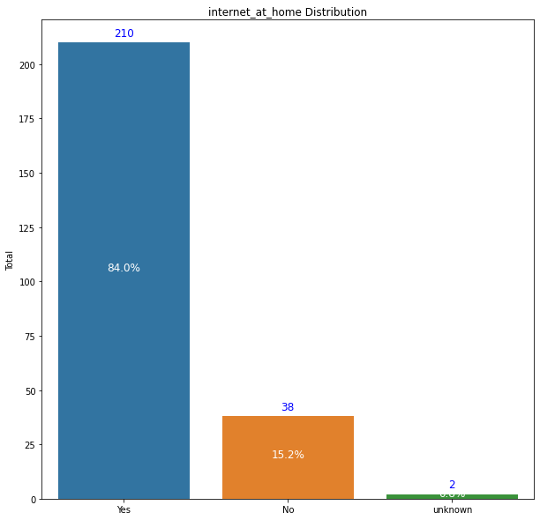
Results
If we were to do all the bootcamp online what percentage of students would have an internet connection?
This graph show us 84% of the students would have an internet connection.

Slide 23
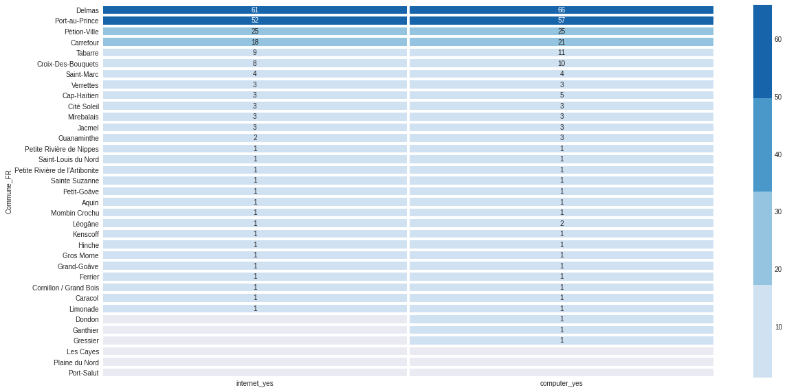
Results
If we were to do all the bootcamp who would be the best commune if the criteria is the higher percentage students who have a laptop and an internet connection at the same time?
As we can see the three first commune are the best because they have the higher ratio of internet and compuer access at the same time.

Slide 24
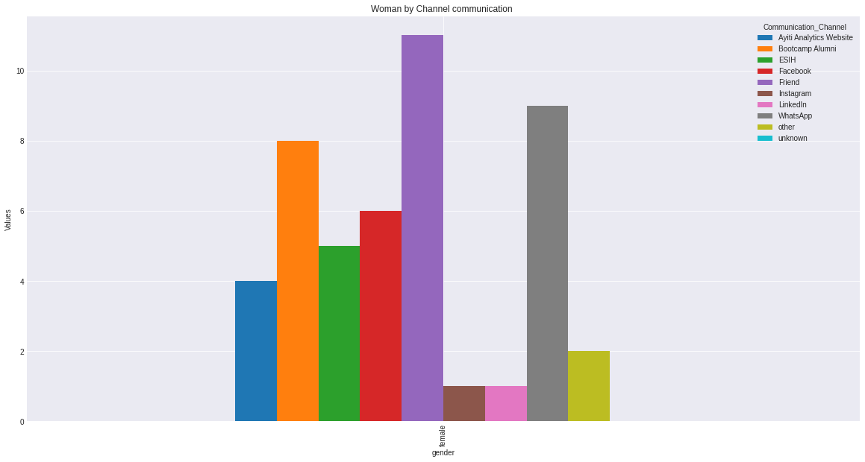
Results
What are the most effective communication channels(Alumni, Facebook, WhatsApp, Friend.. that will allow a women to be susceptible to selection?
The three best channel who will allow a women to be susceptible to selection if we do a hypothesis of all the have the same change to be selected: “Friend,Whatsapp,Bootcamp Alumni”

Slide 25
Recommendations
I recommend to AyitiAnalytics to open these next data analysis centers in Port-au-Prince, Delmas, and Petion-Ville because these municipalities not only concentrate the most interested, they also have the highest rate of internet access and at the laptop. it is also assumed that they have greater access to electricity.

Slide 26
Recommendations
In order to really be able to open a new data analysis center, AyitiAnalytics must be able to ensure that it has enough resources to allow it to operate 3 analysis centers simultaneously and also to expand its team.
It has been assumed that this will cost around 3 times AyitiAnalytics' current service budget. But since we have no clue as to the value of operating costs, no reliable enough balance sheet can be given to you.

Slide 27

Appendix
What resources can the audience use to further understand the message and story being presented?
For further informations, please visit:
-https://github.com/ChasnickDesir1995/Mini-Project-Python.git
-https://www.udemy.com/course/the-data-science-course-complete-data-science-bootcamp/?gclid=CjwKCAjww-CGBhALEiwAQzWxOpOa071v6gueMbkH8PmCgDNkx-k1OgX8RZL54b_e1n8XYOBk3mDfxxoCFv0QAvD_BwE&matchtype=b&utm_campaign=DataAnalysis_v.PROF_la.EN_cc.ROW_ti.5328&utm_content=deal4584&utm_medium=udemyads&utm_source=adwords&utm_term=_._ag_79708696294_._ad_392288196921_._kw_%2Bdata+%2Banalysis+%2Bmethods_._de_c_._dm__._pl__._ti_kwd-625247627413_._li_1007622_._pd__._
-https://hackr.io/blog/what-is-data-analysis-methods-techniques-tools

